Slide 1
Chapter 5
Constraints, Choices, and Demand
McGraw-Hill/Irwin
Copyright © 2008 by The McGraw-Hill Companies, Inc. All Rights Reserved.

Slide 2
Main Topics
Affordable consumption bundles
Consumer choice
Utility maximization
Prices and demand
Income and demand
How economists determine a consumer’s preferences
5-<number>

Slide 3

The Consumer’s Budget Constraint
Consumer can afford to purchase a bundle if its cost is less than her income for that period:
More formally, the bundle is affordable if:
And exhausts the consumer’s income if costs strictly equal income (M)
This is the consumer’s budget constraint
5-<number>

Slide 4
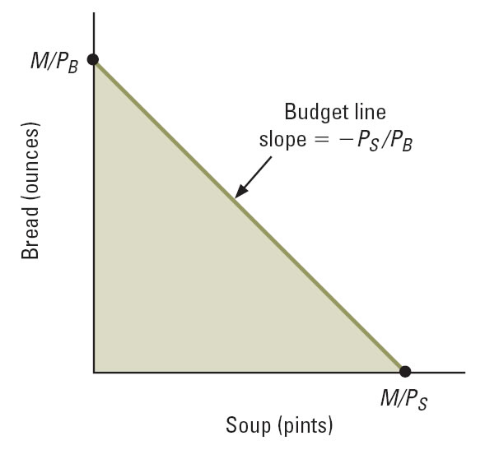
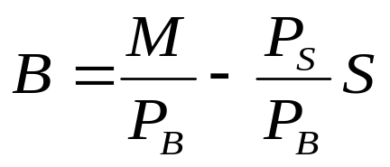
Figure 5.1: The Budget Constraint
Equation of the budget line:
Bundles in the shaded area are affordable but do not exhaust income
Bundles on the budget line exhaust income
5-<number>

Slide 5
Changes in Income and Prices
Change in income alters intercepts of the budget line but does not change its slope
  Reduction in income shifts budget line in
  Increase in income shifts budget line out
Change in price of a good pivots the budget line at the intercept of the good with the unchanged price
  Outward for a price decrease
  Inward for a price increase
5-<number>

Slide 6
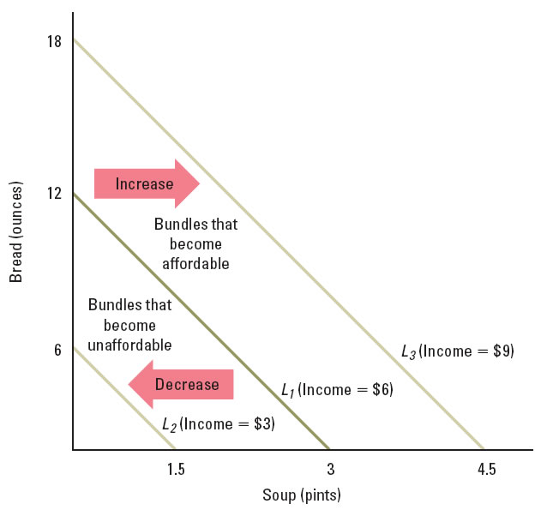
Figure 5.2: Effects of Changes in Income on the Budget Line
5-<number>

Slide 7
Figure 5.3: Effects of a Change in the Price of Soup
12
L₄ (soup costs $6 per pint)
L₁ (soup costs $2 per pint)
Bread (ounces)
L₅ (soup costs $1 per pint)
Increase
Decrease
Bundles that become unaffordable
Bundles that become affordable
1
3
6
Soup (pints)
5-<number>

Slide 8
Properties of Budget Lines
Budget line is the boundary that separates affordable bundles from all others
Slope of budget line = -P_{X}/P_{Y}
X-intercept is M/P_{X}; Y-intercept is M/P_{Y}
Change in income shifts the line without changing its slope
Change in the price of a good rotates the line
Changing prices and income by the same proportion has no effect on the budget line
5-<number>

Slide 9
Sample Problem 1:
Little Tommy spends all of his weekly allowance ($20) on Swiss Chocolate and toy cars. Chocolates are $1 each while toy cars are $5 each. Plot Tommy’s budget line.
What happens to Tommy’s budget line if the price of chocolate rises to $2? If his allowance rises to $30?

Slide 10
Consumer Choice
Choice principle suggests a consumer will choose the highest-ranked available option
Graphically, this means:
  A bundle on the budget line, not below it
  A bundle on the highest indifference curve that touches the budget line
5-<number>

Slide 11
The No-Overlap Rule
The area above the indifference curve that runs through the consumer’s best bundle does not overlap with the area below the budget line.
The area above the indifference curve that runs through any other bundle does overlap with the area below the budget line
5-<number>

Slide 12
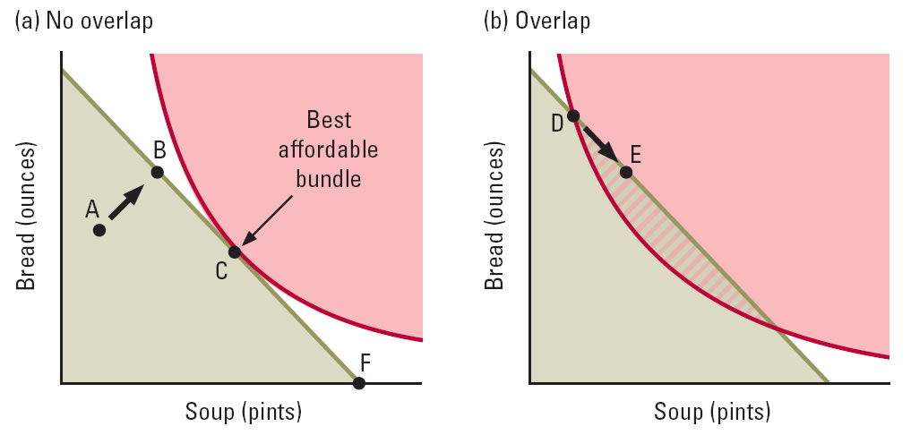
Figure 5.6: Choosing Among Affordable Bundles
5-<number>

Slide 13
MRS and Optimal Choice
At every interior solution, the budget line lies tangent to the indifference curve at the chosen consumption bundle
Recall that:
  Slope of the indifference curve is -MRS_{XY}
  And slope of the budget line is -P_{X}/P_{Y}
Thus at an interior solution:
  MRS_{XY}=P_{X}/P_{Y}
5-<number>

Slide 14
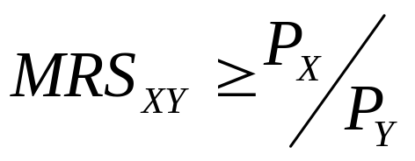
Boundary Solutions
At a boundary choice there are no affordable bundles that contain either a little more or a little less of some good
More formally, when bundle C is a boundary solution:
Often occur when a good provides little value per dollar relative to other alternatives
5-<number>

Slide 15
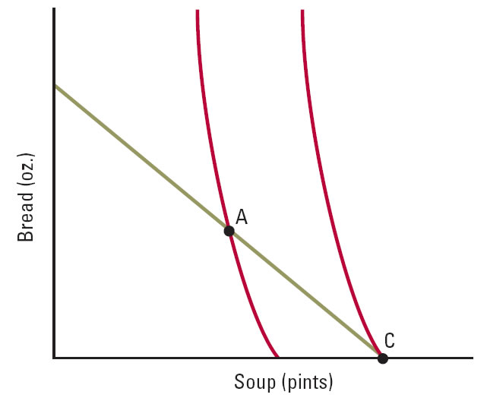
Figure 5.9: A Boundary Solution
Bundle C is the best affordable bundle
C is also a boundary solution
5-<number>

Slide 16
Properties of Best Choices
Assuming that more is better, the consumer’s best choice lies on the budget line
The no-overlap rule identifies best choices
MRS_{XY}=P_{X}/P_{Y} for interior solutions
When indifference curves have declining MRS, any interior choice that satisfies the tangency condition is a best affordable choice
At a boundary solution, MRS_{XY}≥P_{X}/P_{Y}
5-<number>

Slide 17
Utility Maximization
Mathematically, the best bundle maximizes the consumer’s utility function while respecting his budget constraint:
  Maximize U(S,B) subject to P_{S}S+P_{B}B≤Μ
Can solve by comparing individual bundles if number of choices available is small
If finely divisible goods, can solve using calculus
Basic principles can be applied without calculus:
  think about consumer moving along his budget line in search of consumption bundle with highest utility
5-<number>
Notes:
S is pints of soup, B is ounces of bread, Ps is the price of a pint of soup, Pb is the price of an ounce of bread, and M is income.

Slide 18
Utility Maximization
Shifting income from (e.g.) soup to bread results in:
  ↓ in utility from decrease in soup consumed,
  ↑ in utility from increase in bread consumed
Size of these costs and benefits depends on the prices of the two goods and the consumer’s preferences
Shifting $1 from soup to bread:
  Can purchase 1/P_{B} ounces of bread, gaining MU_{B}/P_{B} utility from the increase
  Must forego 1/P_{S} ounces of soup, losing MU_{S}/P_{S} utility from the decrease
The best choice is achieved when the marginal utility per dollar spent is equal across goods
5-<number>

Slide 19
Price-Consumption Curve
Consumer theory facilitates study of the properties of demand curves
How will a consumer’s purchases of a good vary with its price?
The price-consumption curve answers this question, holding everything else fixed
5-<number>

Slide 20
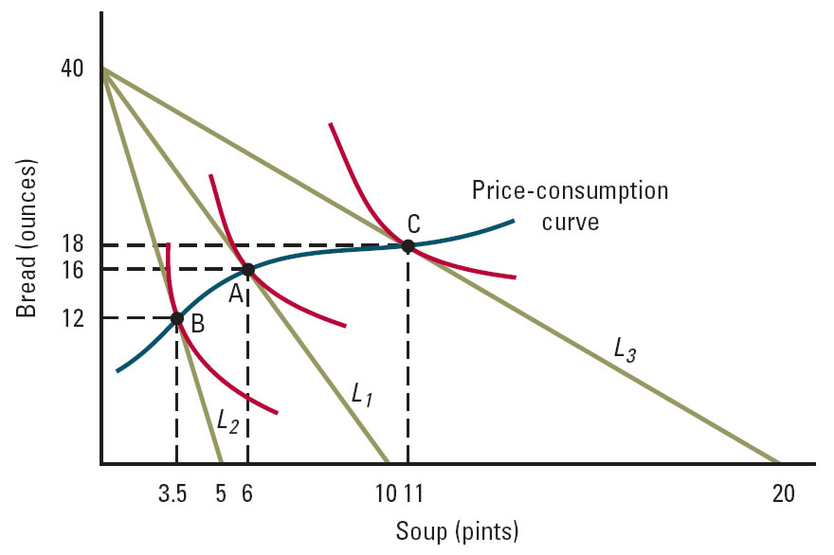
Figure 5.11: Effect of a Change in the Price of Soup on Consumption
5-<number>

Slide 21
Individual Demand Curves
Price-consumption curve includes all the information needed to plot an individual’s demand curve
An individual demand curve:
  Describes the relationship between the prices of a good and the amount a consumer purchases
  Holds everything else fixed
Price elasticity of demand measures sensitivity of amount purchased to changes in the good’s price
5-<number>

Slide 22
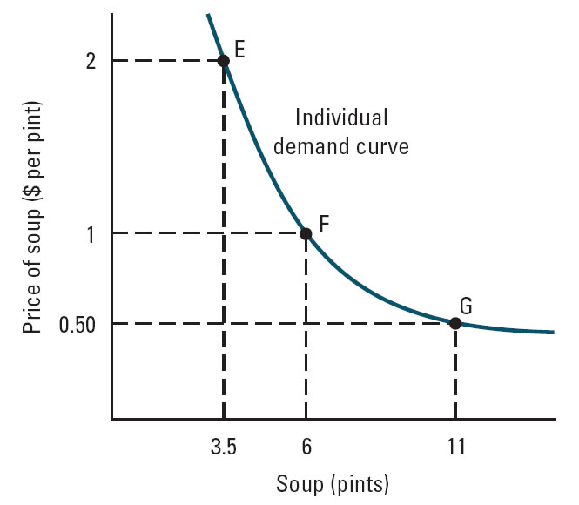
Figure 5.12: Individual Demand Curve for Soup
5-<number>

Slide 23
Sample Problem 2 (5.11)
As in worked-out problems 5.2 and 5.5 (pp. 136 and
146), imagine that Natasha spends all of her
monthly income on tickets to concerts and films.
Suppose the formula for her MRS = (3 + F)/(2C).
(Fractions of tickets are allowed.) Suppose
Natasha’s income is $300/month. Concert tickets
cost $5 each. Draw her price-consumption curve
(allowing the price of film tickets to vary) and draw
her demand curve for film tickets.

Slide 24
Income and Demand
Income is another important consideration in consumer decisions
A change in consumption that results from a change in income is called an income effect
How do a consumer’s choices vary as his income changes?
The income-consumption curve shows this, holding everything else fixed
5-<number>

Slide 25
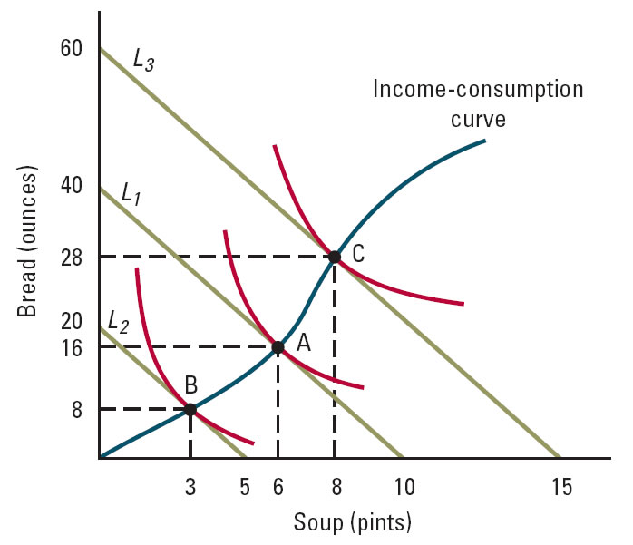
Figure 5.17: Effect of a Change in Income on Consumption
5-<number>

Slide 26
Normal vs. Inferior Goods
If a good is normal, an increase in income raises the amount that is consumed
If a good is inferior, an increase in income decreases the amount that is consumed
Consumption of many goods falls as income rises because people shift toward higher-quality products that fill similar needs
  Examples: replace posters with art reproductions, margarine with butter
5-<number>

Slide 27
Properties of Normal and Inferior Goods
Income elasticity is positive for normal goods, negative for inferior goods
Slope of income-consumption curve shows whether a good is normal or inferior
At least one good must be normal
No good can be inferior at all levels of income
5-<number>

Slide 28
Engel Curves
The Engel curve for a good shows the relationship between income and the amount consumed, holding everything else fixed
Measure income on the vertical axis and amount consumed on the horizontal axis
Engel curve slopes upward for a normal good and downward for an inferior one
5-<number>

Slide 29
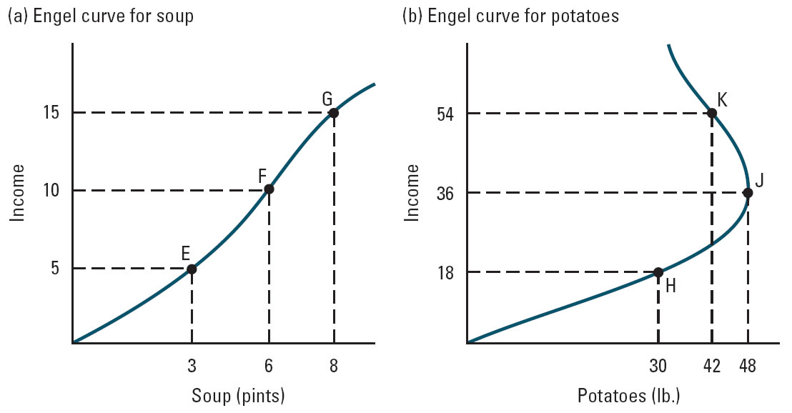
Figure 5.20: Engel Curves for Soup and Potatoes
5-<number>

Slide 30
Changes in Income and
Shifts in Demand
Demand curve shows relationship between price of a good and the amount purchased, holding everything else fixed, including income
If income changes, the demand curve shifts
If the good is normal
  Income increase raises consumption at every price, so demand shifts to the right
  Income decrease shifts demand to the left
If the good is inferior, the effects are reversed
5-<number>

Slide 31
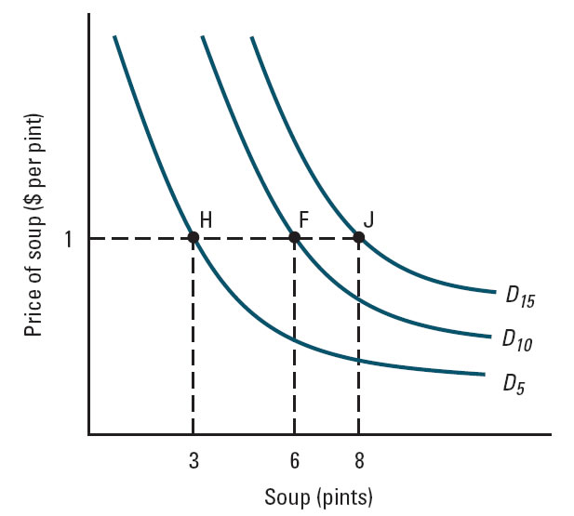
Figure 5.22: Changes in Income Shift Demand
5-<number>

Slide 32
Sample Problem 3 (5.14)
Ashley spends all of her income on gasoline
and food. At first she earns $100, buys 25
gallons of gas at $2/gallon, and purchases 10
pounds of food at $5/lb. Her income later
rises to $200, but the price of gasoline rises
to $5/gallon, and the price of food rises to
$7/lb. Is she better or worse off? Why?

